Slide 1
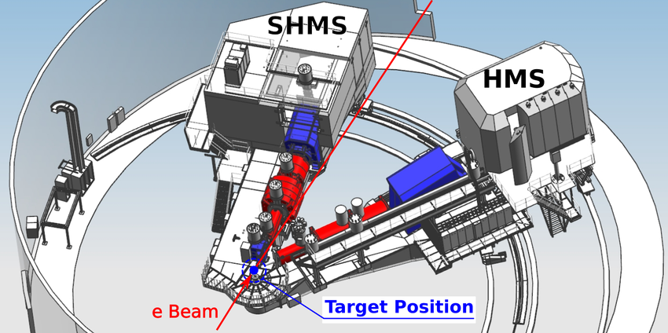
The Reaction
Deuteron coincidence reaction taking place in Jlab Hall C
Protons are detected in the High Momentum Spectrometer (HMS)
Electrons are detected in the Super High Momentum Spectrometer (SHMS)

Slide 2
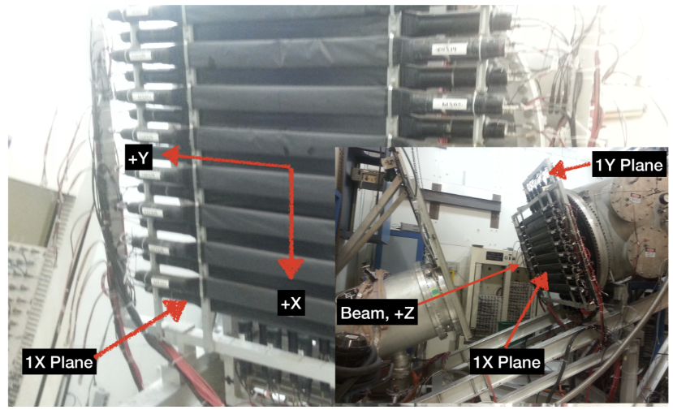
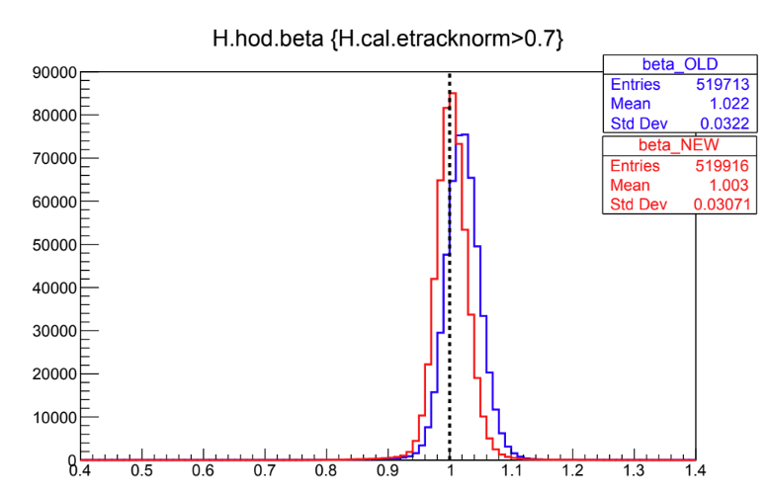
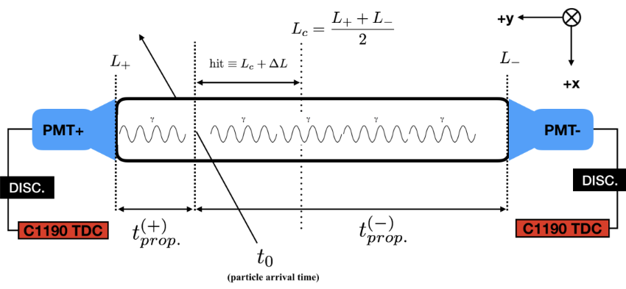
The Hodocope consist of stacked panels of Scintillators with a photomultiplier tube (PMT) on both sides.
It measures the relativistic velocity of the incoming particles
However, when it does this, it is not completely accurate, so it must calibrated so it can accurately reflect the velocity of the particles.

